Slide 1




Statistical Methods for
Estimating Abundance in Ecology

Slide 2
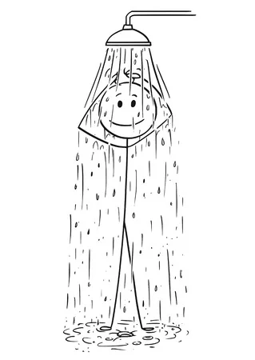
Lather-Rinse-Repeat

Slide 3
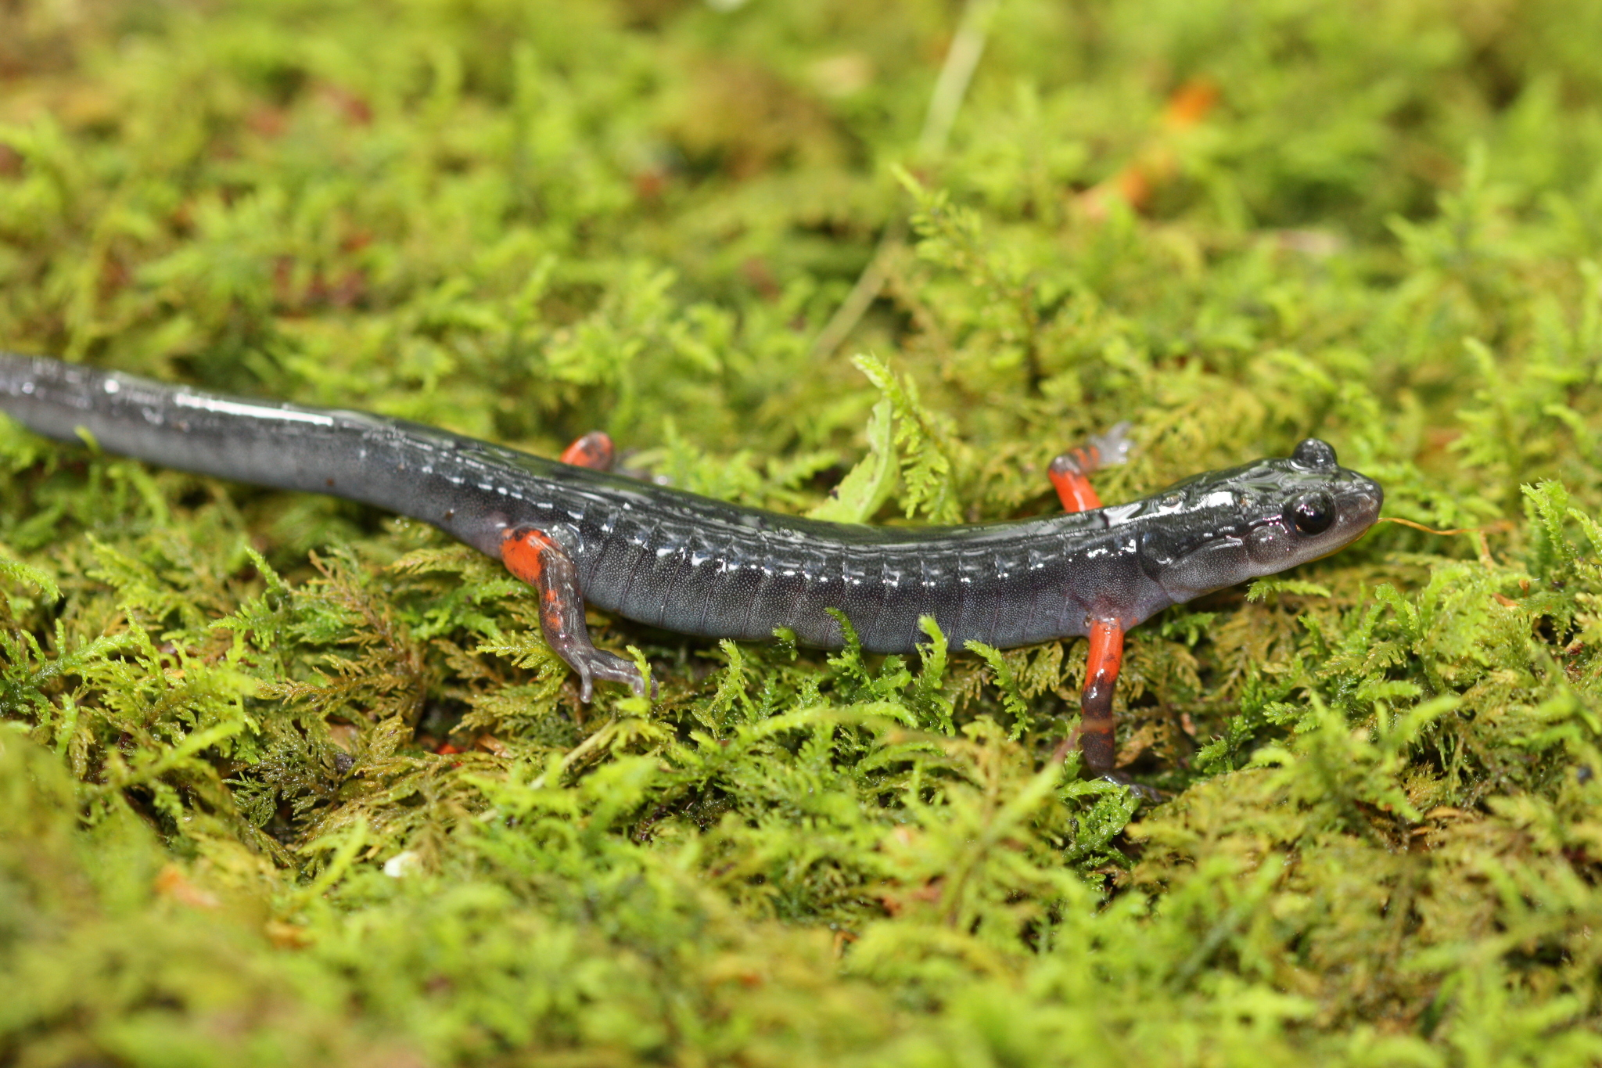
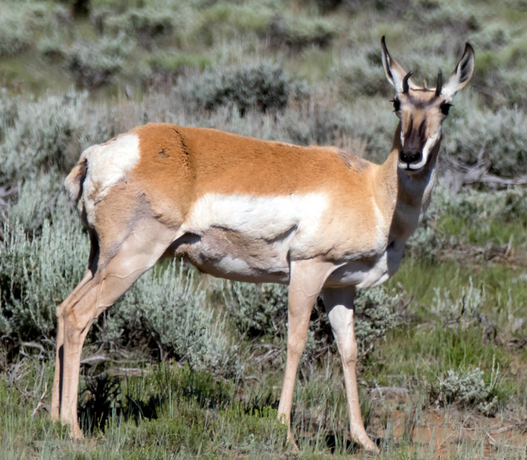
Capture-Mark-Recapture
Method used to estimate the abundance of biological populations that involves ‘capturing’ individuals, ‘marking’ them, releasing them back into the population, and then determining the ratio of marked to unmarked individuals in the population during ‘recapture’ surveys
If we can estimate the abundance of organisms like salamanders and pronghorn by counting them, why go through the trouble of capturing and marking them?
(iNaturalist)
(Amy Hunt)

Slide 4
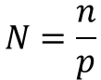
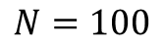
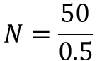
Estimating Abundance – Closed Population Estimation
$$Population size= \frac{\# of individuals marked}{probability of capturing an individual at least once}$$
$$N=\frac{n}{p}$$
$$N=\frac{50}{0.5}$$
$$N=100$$

Slide 5
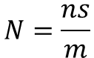
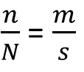
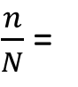
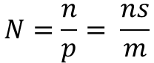
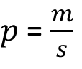
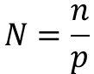
Estimating Abundance – Lincoln-Peterson Estimator
N = abundance (what we want to estimate)
n = number of individuals captured & marked during survey 1
m = number of individuals in survey 2 that were marked during survey 1
s = total number of individuals captured during survey 2
$\frac{n}{N}$ =
$\frac{n}{N}$ = $\frac{m}{s}$
$$N=\frac{ns}{m}$$
$$N=\frac{n}{p}$$
$p$ = $\frac{m}{s}$
$$N=\frac{n}{p}= \frac{ns}{m}$$

Slide 6

Estimating Abundance – Lincoln-Peterson Estimator
N = abundance (what we want to estimate)
n = number of individuals captured & marked during survey 1
m = number of individuals in survey 2 that were marked during survey 1
s = total number of individuals captured during survey 2
$\frac{n}{N}$ =
$\frac{n}{N}$ = $\frac{m}{s}$
$$N=\frac{ns}{m}$$
$$N=\frac{n}{p}$$
$p$ = $\frac{m}{s}$
$$N=\frac{n}{p}= \frac{ns}{m}$$

Slide 7
Estimating Abundance – Lincoln-Peterson Estimator
N = abundance (what we want to estimate)
n = number of individuals captured & marked during survey 1
m = number of individuals in survey 2 that were marked during survey 1
s = total number of individuals captured during survey 2
$\frac{n}{N}$ =
$\frac{n}{N}$ = $\frac{m}{s}$
$$N=\frac{ns}{m}$$
$$N=\frac{n}{p}$$
$p$ = $\frac{m}{s}$
$$N=\frac{n}{p}= \frac{ns}{m}$$

Slide 8
Estimating Abundance – Lincoln-Peterson Estimator
N = abundance (what we want to estimate)
n = number of individuals captured & marked during survey 1
m = number of individuals in survey 2 that were marked during survey 1
s = total number of individuals captured during survey 2
$\frac{n}{N}$ =
$\frac{n}{N}$ = $\frac{m}{s}$
$$N=\frac{ns}{m}$$
$$N=\frac{n}{p}$$
$p$ = $\frac{m}{s}$
$$N=\frac{n}{p}= \frac{ns}{m}$$

Slide 9
Estimating Abundance – Lincoln-Peterson Estimator
N = abundance (what we want to estimate)
n = number of individuals captured & marked during survey 1
m = number of individuals in survey 2 that were marked during survey 1
s = total number of individuals captured during survey 2
$\frac{n}{N}$ =
$\frac{n}{N}$ = $\frac{m}{s}$
$$N=\frac{ns}{m}$$
$$N=\frac{n}{p}$$
$p$ = $\frac{m}{s}$
$$N=\frac{n}{p}= \frac{ns}{m}$$
Survey 2
Survey 1

Slide 10
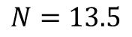
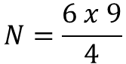
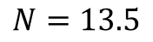
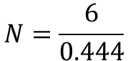
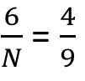
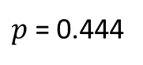
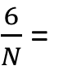
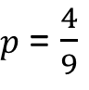
Estimating Abundance – Lincoln-Peterson Estimator
N = abundance (what we want to estimate)
n = number of individuals captured & marked during survey 1
m = number of individuals in survey 2 that were marked during survey 1
s = total number of individuals captured during survey 2
$\frac{n}{N}$ =
$\frac{n}{N}$ = $\frac{m}{s}$
$$N=\frac{ns}{m}$$
$$N=\frac{n}{p}$$
$p$ = $\frac{m}{s}$
$$N=\frac{n}{p}= \frac{ns}{m}$$
$\frac{6}{N}$ =
$\frac{6}{N}$ = $\frac{4}{9}$
$$N=\frac{6 x 9}{4}$$
$p$ = $\frac{4}{9}$
$$N=\frac{6}{0.444}$$
$$N=13.5$$
$$N=13.5$$
$p$ = 0.444

Slide 11
Estimating Abundance – Closed Population Estimation
Model Parameters
p = capture probability
c = recapture probability
f0 = the number of individuals never captured
Questions
1. Differences between detection probability and capture probability?
2. Why different parameters for capture probability and recapture probability?
3. What the heck is f0?
f0 = N – M
N = f0 + M
Population abundance (N) is a derived parameter in these models

Slide 12
Estimating Abundance – Closed Population Estimation
1. Question
2. Field Data
3. Format Data for Analysis
4. Fit Population Model
5. Examine Output and Visualize Results
*steps 3-5 in Program R

Slide 13

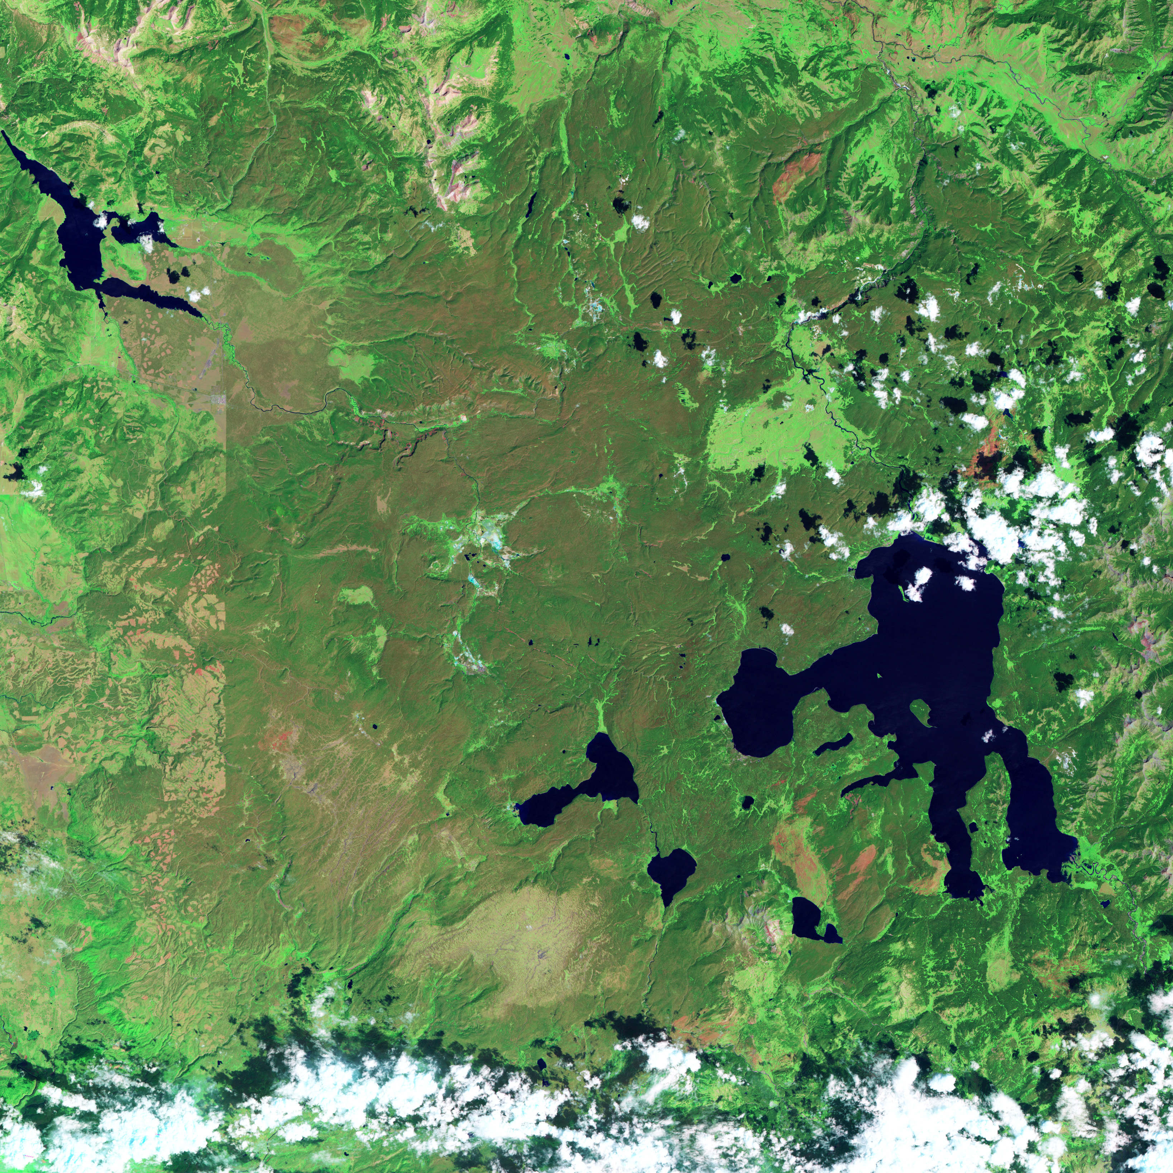
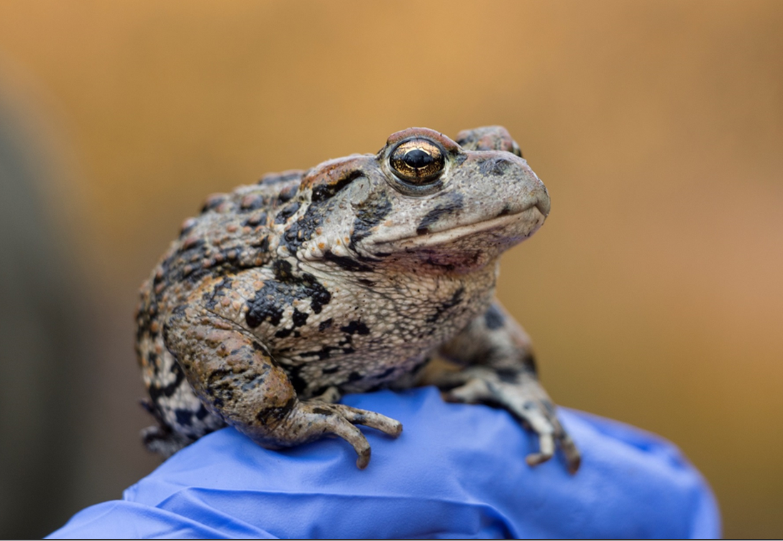
Estimating Abundance – Closed Population Estimation
1. Question
How does boreal toad abundance vary across ponds?
x
J. Grant

Slide 14
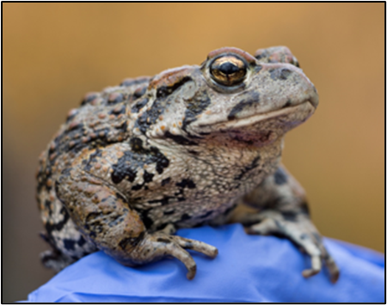
Estimating Abundance – Closed Population Estimation
1. Question
How does boreal toad abundance vary across ponds?
Date | Pond | Survey | SVL | Tag

Slide 15
Estimating Abundance – Closed Population Estimation
1. Question
How does boreal toad abundance vary across ponds?
Date | Pond | Survey | SVL | Tag
5/29/2015 | 1 | 1

Slide 16
Estimating Abundance – Closed Population Estimation
1. Question
How does boreal toad abundance vary across ponds?
Date | Pond | Survey | SVL | Tag
5/29/2015 | 1 | 1 | 65

Slide 17
Estimating Abundance – Closed Population Estimation
1. Question
How does boreal toad abundance vary across ponds?
Date | Pond | Survey | SVL | Tag
5/29/2015 | 1 | 1 | 65 | 100

Slide 18
Estimating Abundance – Closed Population Estimation
1. Question
How does boreal toad abundance vary across ponds?
Date | Pond | Survey | SVL | Tag
5/29/2015 | 1 | 1 | 65 | 100
5/29/2015 | 1 | 1 | 75 | 101
5/29/2015 | 1 | 1 | 68 | 102
5/29/2015 | 1 | 1 | 80 | 103
5/29/2015 | 1 | 1 | 60 | 104
5/29/2015 | 1 | 1 | 89 | 105
5/29/2015 | 1 | 1 | 82 | 106

Slide 19
Estimating Abundance – Closed Population Estimation
1. Question
How does boreal toad abundance vary across ponds?
Date | Pond | Survey | SVL | Tag
5/29/2015 | 1 | 1 | 65 | 100
5/29/2015 | 1 | 1 | 75 | 101
5/29/2015 | 1 | 1 | 68 | 102
5/29/2015 | 1 | 1 | 80 | 103
5/29/2015 | 1 | 1 | 60 | 104
5/29/2015 | 1 | 1 | 89 | 105
5/29/2015 | 1 | 1 | 82 | 106
6/1/2015 | 1 | 2

Slide 20
Estimating Abundance – Closed Population Estimation
1. Question
How does boreal toad abundance vary across ponds?
Date | Pond | Survey | SVL | Tag
5/29/2015 | 1 | 1 | 65 | 100
5/29/2015 | 1 | 1 | 75 | 101
5/29/2015 | 1 | 1 | 68 | 102
5/29/2015 | 1 | 1 | 80 | 103
5/29/2015 | 1 | 1 | 60 | 104
5/29/2015 | 1 | 1 | 89 | 105
5/29/2015 | 1 | 1 | 82 | 106
6/1/2015 | 1 | 2 | 58

Slide 21
Estimating Abundance – Closed Population Estimation
1. Question
How does boreal toad abundance vary across ponds?
Date | Pond | Survey | SVL | Tag
5/29/2015 | 1 | 1 | 65 | 100
5/29/2015 | 1 | 1 | 75 | 101
5/29/2015 | 1 | 1 | 68 | 102
5/29/2015 | 1 | 1 | 80 | 103
5/29/2015 | 1 | 1 | 60 | 104
5/29/2015 | 1 | 1 | 89 | 105
5/29/2015 | 1 | 1 | 82 | 106
6/1/2015 | 1 | 2 | 58 | 107

Slide 22
Estimating Abundance – Closed Population Estimation
1. Question
How does boreal toad abundance vary across ponds?
Date | Pond | Survey | SVL | Tag
5/29/2015 | 1 | 1 | 65 | 100
5/29/2015 | 1 | 1 | 75 | 101
5/29/2015 | 1 | 1 | 68 | 102
5/29/2015 | 1 | 1 | 80 | 103
5/29/2015 | 1 | 1 | 60 | 104
5/29/2015 | 1 | 1 | 89 | 105
5/29/2015 | 1 | 1 | 82 | 106
6/1/2015 | 1 | 2 | 58 | 107
6/1/2015 | 1 | 2 | 68

Slide 23
Estimating Abundance – Closed Population Estimation
1. Question
How does boreal toad abundance vary across ponds?
Date | Pond | Survey | SVL | Tag
5/29/2015 | 1 | 1 | 65 | 100
5/29/2015 | 1 | 1 | 75 | 101
5/29/2015 | 1 | 1 | 68 | 102
5/29/2015 | 1 | 1 | 80 | 103
5/29/2015 | 1 | 1 | 60 | 104
5/29/2015 | 1 | 1 | 89 | 105
5/29/2015 | 1 | 1 | 82 | 106
6/1/2015 | 1 | 2 | 58 | 107
6/1/2015 | 1 | 2 | 68 | 102

Slide 24
Estimating Abundance – Closed Population Estimation
1. Question
How does boreal toad abundance vary across ponds?
Date | Pond | Survey | SVL | Tag
5/29/2015 | 1 | 1 | 65 | 100
5/29/2015 | 1 | 1 | 75 | 101
5/29/2015 | 1 | 1 | 68 | 102
5/29/2015 | 1 | 1 | 80 | 103
5/29/2015 | 1 | 1 | 60 | 104
5/29/2015 | 1 | 1 | 89 | 105
5/29/2015 | 1 | 1 | 82 | 106
6/1/2015 | 1 | 2 | 58 | 107
6/1/2015 | 1 | 2 | 68 | 102
6/1/2015 | 1 | 2 | 76 | 108
6/1/2015 | 1 | 2 | 75 | 101
6/1/2015 | 1 | 2 | 67 | 109
6/1/2015 | 1 | 2 | 81 | 110

Slide 25
Estimating Abundance – Individual Capture Histories
Pond | Survey | Tag
1 | 1 | 100
1 | 2 | 100
1 | 3 | 100
1 | 4 | 100
1 | 1 | 101
1 | 3 | 101
1 | 2 | 102
1 | 4 | 102
Tag | Survey 1 | Survey 2 | Survey 3 | Survey 4
100 | 1 | 1 | 1 | 1
101 | 1 | 0 | 1 | 0
102 | 0 | 1 | 0 | 1

Slide 26
Estimating Abundance – Individual Capture Histories
Pond | Survey | Tag
1 | 1 | 100
1 | 2 | 100
1 | 3 | 100
1 | 4 | 100
1 | 1 | 101
1 | 3 | 101
1 | 2 | 102
1 | 4 | 102
Tag | Survey 1 | Survey 2 | Survey 3 | Survey 4
100 | 1 | 1 | 1 | 1
101 | 1 | 0 | 1 | 0
102 | 0 | 1 | 0 | 1

Slide 27
Estimating Abundance – Individual Capture Histories
Pond | Survey | Tag
1 | 1 | 100
1 | 2 | 100
1 | 3 | 100
1 | 4 | 100
1 | 1 | 101
1 | 3 | 101
1 | 2 | 102
1 | 4 | 102
Tag | Survey 1 | Survey 2 | Survey 3 | Survey 4
100 | 1 | 1 | 1 | 1
101 | 1 | 0 | 1 | 0
102 | 0 | 1 | 0 | 1
Toad 100: 1111
Toad 101: 1010
Toad 102: 0101

Slide 28
Estimating Abundance – Closed Population Estimation
R Script: Day3-CaptureRecapture_RMark
Breakout rooms: one person in group will volunteer to share screen
Work through the code: answer each question as a group
Instructors will be available to help you along

Slide 29
Capture-Recapture vs Count Data
Advantages to collecting count data? Disadvantages?
Advantages to collecting capture-recapture data? Disadvantages?
When would you collect capture-recapture data?
When would you collect count data?
(Jessica Grant)
(Amy Hunt)

Slide 30

Capture-Recapture vs Count Data
N = 100

Slide 31
Capture-Recapture vs Count Data
N = 100

Slide 32
Capture-Recapture vs Count Data
N = 100
10
10
10

Slide 33
Estimating Abundance – Closed Population Estimation
Any questions?
Does anyone want to go over anything again?

Slide 34
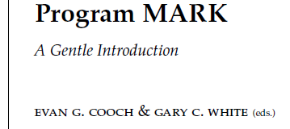



Estimating Abundance – Closed Population Estimation

Slide 35
Estimating Abundance – Closed Population Estimation
Session on Monday (12/6)
Instructors will be available to help with:
Any questions you have
Working through issues with your own data
More complex examples of estimating abundance
Just to chat about life

